Slide 1
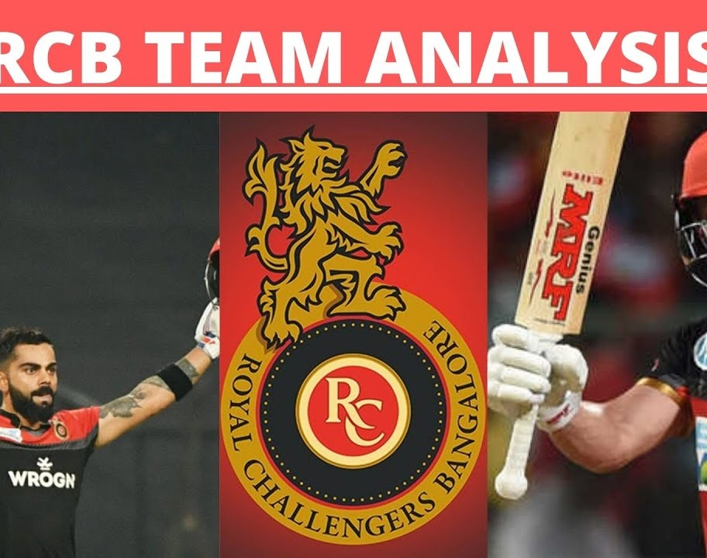
RCB IPL ANALYSIS
Prem Karthick
01-04-2025

Slide 2
Introduction and Objectives
Introduction
Welcome to the Royal Challengers Bangalore (RCB) IPL Analysis. This presentation aims to provide a comprehensive overview of RCB’s performance, strategies, and key insights from the 2017 mega player auction. Our goal is to identify top-performing and reliable players who can help RCB win tournaments while optimizing player auction investments.
“From Data to Dominance: RCB’s Winning Formula”

Slide 3

AGENDA
01
02
03
04
Problem Statement
Data Description
Objective Key Metrics and Visualizations
Insights from Subjective Question

Slide 4
Objective
What is the total number of run scored in 1st season by RCB (bonus : also include the extra runs using the extra runs table)
How many players were more than age of 25 during season 2 ?
How many matches did RCB win in season 1 ?
List top 10 players according to their strike rate in last 4 seasons
What is the average runs scored by each batsman considering all the seasons?
What are the average wickets taken by each bowler considering all the seasons?
List all the players who have average runs scored greater than overall average and who have taken wickets greater than overall average

Slide 5
Data Overview
Analysis Includes with more than 9 seasons
There are 13 Teams were participated in the IPL along with RCB
There 168 matches were won by RCB in past seasons
There are more than 460 players involved in the analysis were played in the IPL in those seasons
More than 10 Venue had placed in most of the IPL held
Most powerful player were placed in RCB who were best enough in skills with both batting and bowling

Slide 6
Data Analysis Techniques
Descriptive Analysis: Basic features of the data were summarized to provide an overview of player performance metrics.
Regression Analysis: Relationships between variables were explored to predict player performance based on historical data.
Cluster Analysis: Players were segmented into categories such as core players, emerging talents, and specialists based on their performance metrics.

Slide 7
Data Visualization
Charts and Graphs: Excel was used to create various charts and graphs, including bar charts, line graphs, and scatter plots, to visually represent player performance and auction data.
Pivot Tables: Pivot tables were utilized to summarize and analyze large datasets, making it easier to identify trends and patterns.
Conditional Formatting: Applied to highlight key performance indicators and outliers, making the data more interpretable at a glance.

Slide 8


Objectives with analysis
How many players were more than age of 25 during season 2 ?
How many matches did RCB win in season 1?
Are there players whose performance is more suited to specific venues or conditions? (how would you present this using charts?)

Slide 9
Which of the given players have consistently performed well in past seasons?

Slide 10
Strategic Recommendations
Chinnaswamy stadium is one of the smallest stadiums in india.
So it always brings fun to the match...batters usually smash the bowlers all around the ground and some rival games agaisnt csk and mi were so iconic in this stadium...
Although it is small, rcb management always fails to find right talent to play at chinnaswamy stadium. this is a major drawback and a substantial reason for their trophy drought.
They must work on their swot analysis
Reduce the threats by hiring better analytical team and bringing in a veteran player as mentor
They must increase their strengths by strengthening their batting line up

Slide 11
The factors contributing to the high-scoring matches and the impact on viewership and team strategies
It compares the performance of different cricket teams in power play and death overs.
Kings XI Punjab leads in both categories, scoring the most runs in power play (22,913) and death overs (15,833).
There's a clear trend showing that teams with higher power play scores generally also have higher death over scores, indicating consistent aggressive batting throughout the innings.
M Chinnaswamy Stadium in Bangalore stands out as the highest-scoring venue with an average of 574 runs per match, while also hosting a significant number of games (58).
Venues with more matches played tend to have higher average run scores

Slide 14
Come up with a visual and analytical analysis of RCB's past season performances and potential reasons for them not winning a trophy.
There's a general upward trend in win percentage, starting at 28.57% in season 1 and ending at 56.25% in season 9.
The win percentage fluctuates between seasons, with notable peaks in seasons 3 and 5, reaching 62.5% at its highest point.

Slide 15
It shows batting performance across multiple seasons, tracking total runs in power play, total balls faced in death overs, and strike rate in power play.
There's significant variation between players, with a few standout performances in runs and balls faced.
The strike rate generally follows a declining trend across the seasons, with some fluctuations.
It depicts bowling performance across seasons for different players, showing runs conceded, balls bowled, wickets taken, and economy rate in death overs.
There's significant variation among players, with some standout performances in wickets taken (e.g., P Kumar, Y Chahal).
Economy rates remain relatively consistent across players, while runs conceded and balls bowled vary more widely.

Slide 16
Conclusion
RCB management lacks positivity.
Players are giving everything for the team-ownership lacks positivity.
Think tank should be changed and key batters like virat ,will jacks and maxwell must be retained.
Bowling should be strengthened
Pick Power Hitters: Auction strategies should prioritize batsmen who have a high strike rate and a proven ability to hit sixes. Players like AB de Villiers and Chris Gayle were vital in RCB's past success at Chinnaswamy due to their power hitting.
Balanced Bowling Attack: Identify bowlers who perform well at high-scoring venues. Bowlers who have good control and are adept at containing runs in death overs would be key to containing the opposition at Chinnaswamy.
Management Stability: Building a consistent management and leadership structure is crucial for long-term success.
Player Backing: Creating a culture where players are backed despite a few failures would improve morale and team cohesion.
Mental Strength: Instilling a winning mentality by embracing pressure and focusing on performing in key moments could help the team break their final hurdles.
Balanced Team: Relying on a few stars has not worked for them. RCB needs to focus on building a well-rounded team where both batting and bowling departments are strong.

Slide 17
THANK YOU

